Slide 1
BUSQOM 1080 Data Processing I
Fall 2020
Lecture 17
Professor: Michael Hamilton

Slide 2
Lecture Summary
Today: Data Cleaning and Processing Methods
Loading in data: read.table(), read.csv() [5 Mins]
Sorting and Sampling data [5 Mins]
Transformations of data [20 Mins]
Outlier detection [10 Mins]
Normalization [5 Mins]
Log transformations [5 Mins]

Slide 3
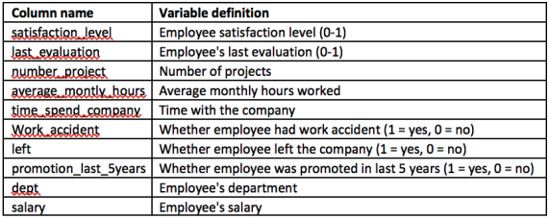
Data for lecture
Save HR_data.txt in your working directory
HR =read.table(”HR_data.txt", sep = "\t", header = T)
14,999 observations about employees at a company.

Slide 4
Loading in Data
read.table() - is a multipurpose work-horse function in base R for importing data.
Example: read.table("mydata.txt", sep = "\t", header = TRUE)
The parameter sep will be how R reads the file.
For .txt files use “\t” for tab separated
For .csv files use “,” or a read.csv() command
The parameter header tells R how to handle the first line of a file.
header = TRUE tells R to read the first line of the file as headers to your features!
read.csv() - is a special case of the read.table() command.
CSV (comma separated values) is one of the most common data types.
If you want to load in csv file you have saved in your working directory try:
> read.csv(“file_name.csv”) OR
> read.csv(“file_name.csv”, header = T)

Slide 5
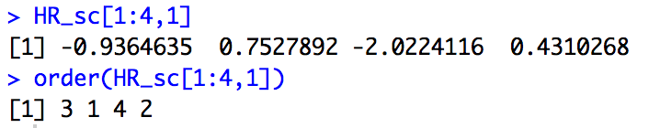
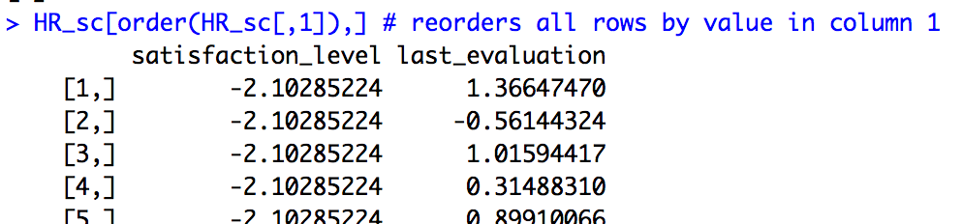
Sorting Data
There will be many times when we will want to arrange data in order of its value (typically the value of a certain feature).
To do so we can use the order() function in R
Note order returns the numeric place of the data!
1 = Highest, 2 = Second highest, etc…
This makes it easy to rearrange Dataframes by certain col’s!
Can use the return from order() as a row index

Slide 6
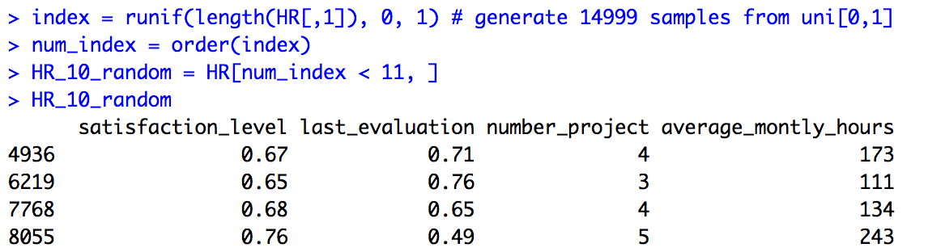
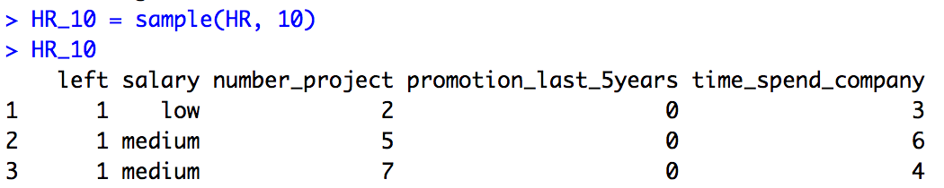
Sorting and Sampling the Data
Motivating Example: Suppose we want to randomly select 10 rows from the dataset HR?
Easier way: Use the sample(data, num_samples) function

Slide 7
Introduction to Data Preprocessing
Once we have a new dataset often we want to manipulate the data into a more amendable form
Cleaning - This refers to the act of removing problems with data include things like: NA’s (recall the is.NA() command when working with the cba data), filling in or removing observations with missing features, and separating into key sets.
Preprocessing – This refers to various transformations on the data that can be applied before running analysis. This includes:
Outlier detection and removal
Normalization
Data transformations

Slide 8
Preprocessing - Outliers
Def: Outlier – An observation so different from the others that one suspects it was generated by a different data generating process or mechanism
Could be caused by an error in the measurements
Could be these samples were fundamentally different from the others
Why do we care about outliers?
Outliers can break the assumptions of our tests
Outliers skew the results of our tests (i.e. t-tests, things based on means)
Removing these points can greatly increase the quality of our analysis

Slide 9
Strategies for Dealing with Outliers
Fundamental Question: Outlier or Rare Event?
An outlier is not necessarily the extreme values in the data i.e. min/max
Rare events are extreme events that can occur under the assumptions, but are not true outliers.
Example: The normal distribution with mean 0, sd 1, is supported on [-∞, ∞]. Very large or small values can occur, but with correspondingly small prob.
How do we know which observations are outliers that should be removed?
Only remove data if you can justify it.
If cannot justify removing outliers, you made need to reconsider the methods used

Slide 10
Outlier Detection via IQR Test
There are many ways to test for potential outliers
IQR Test – A method for outlier detection based on the interquartile range (quartiles are robust to outliers)
IQR = 75% quartile – 25 % quartile
U = 75% quartile + 1.5* IQR
L = 25% quartile - 1.5* IQR
Label data that falls outside of the range [L,U] as an outlier
Three Standard Deviation Rule – Label points more than three sample standard deviations away from the sample mean as outliers.
No test for outliers is perfect
May label rare events as outliers

Slide 11
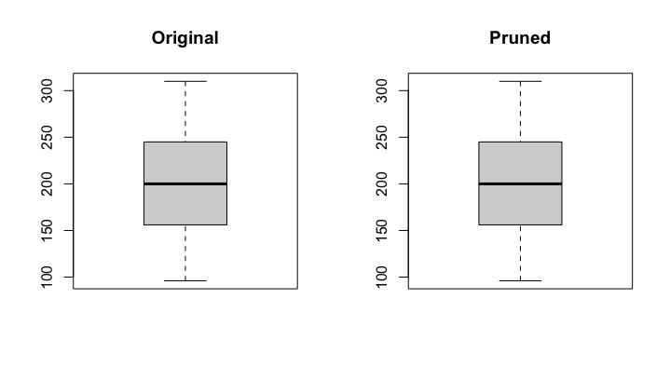
Example: Pruning Outliers
Find outliers by hours worked per month:
quants = quantile(HR$average_montly_hours)
U = quants[4] + 1.5*(quants[4] - quants[2])
L = quants[2] - 1.5*(quants[4] - quants[2])
HR$average_montly_hours< U & HR$average_montly_hours> L
HR_clean = HR[HR$average_montly_hours < U & HR$average_montly_hours> L,]
par(mfrow = c(1,2))
boxplot(HR$average_montly_hours)
boxplot(HR_clean$average_montly_hours)
Turns out there’s no outliers in this data (by the IQR rule)!

Slide 12
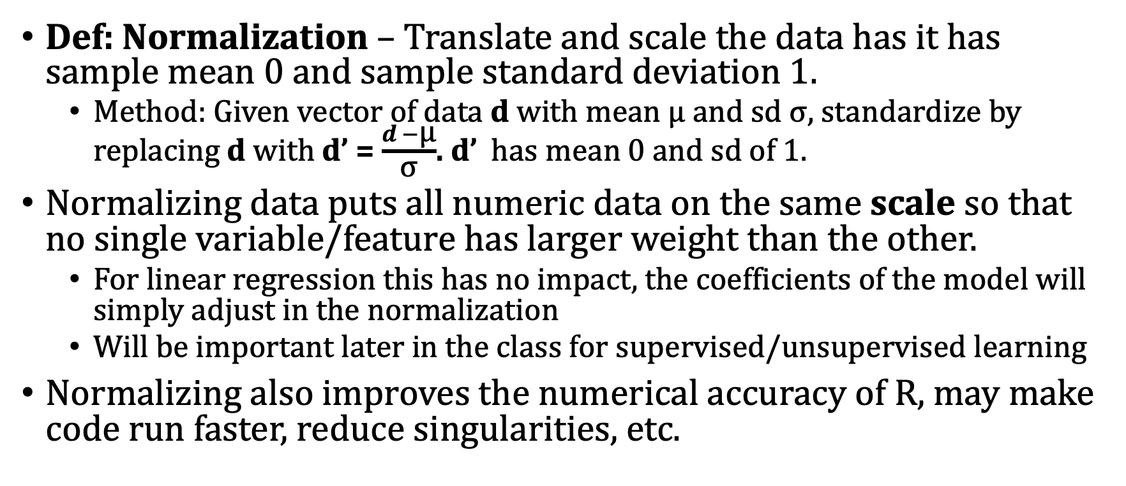
Preprocessing - Data Normalization
Def: Normalization – Translate and scale the data has it has sample mean 0 and sample standard deviation 1.
Method: Given vector of data d with mean μ and sd σ, standardize by replacing d with d’ = $\frac{d −\text{μ}}{\text{σ}}$. d’ has mean 0 and sd of 1.
Normalizing data puts all numeric data on the same scale so that no single variable/feature has larger weight than the other.
For linear regression this has no impact, the coefficients of the model will simply adjust in the normalization
Will be important later in the class for supervised/unsupervised learning
Normalizing also improves the numerical accuracy of R, may make code run faster, reduce singularities, etc.

Slide 13
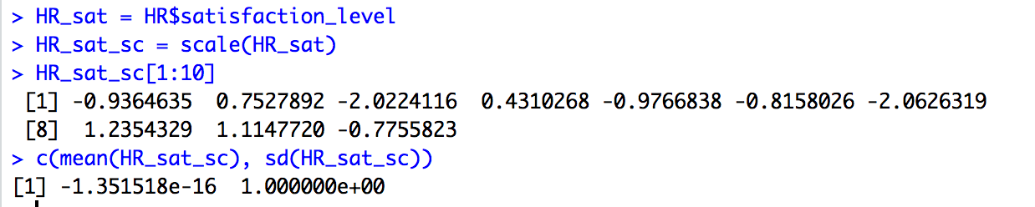
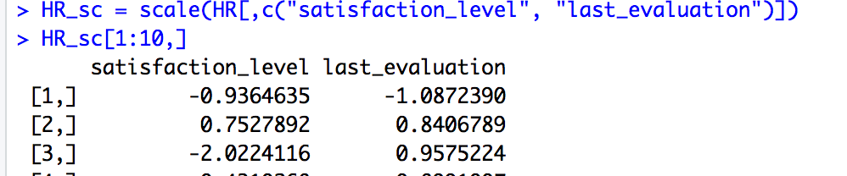
Data Normalization using scale()
In R the scale() function will normalize our data.
Can normalize whole data.frames (note scale can only take in numeric features! Also note it returns a matrix not a data.frame.

Slide 14
Preprocessing - Transformations
Problem: Sometimes the data might not fit the assumptions of a particular test or regression.
Stabilize Variance (across observations)
Remove Curvature (in the residuals)
Remove Asymmetry
Solution Idea: Transform the response data by some function so that the assumptions are satisfied.
Why? Since the scale of measurement is arbitrary, it is valid to transform a variable into a scale that best satisfies the assumptions of the analysis.

Slide 15
Quick Review of Logarithms
log(ab) = log(a) + log(b)

Slide 16
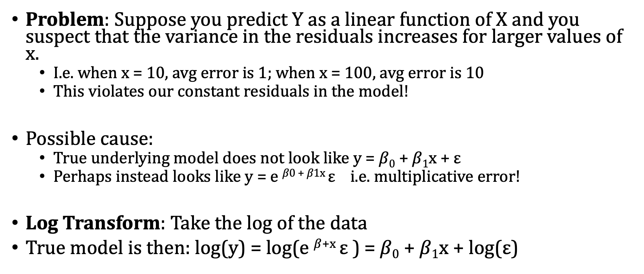
The Log Transformation
Problem: Suppose you predict Y as a linear function of X and you suspect that the variance in the residuals increases for larger values of x.
I.e. when x = 10, avg error is 1; when x = 100, avg error is 10
This violates our constant residuals in the model!
Possible cause:
True underlying model does not look like y = $β0$ + $β1$x + ε
Perhaps instead looks like y = e $β0$⁺ $β1$^{x} ε i.e. multiplicative error!
Log Transform: Take the log of the data
True model is then: log(y) = log(e $β$^{+x} ε ) = $β0$ + $β1$x + log(ε)

Slide 17
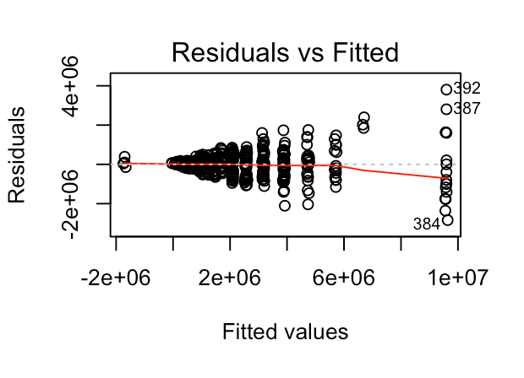
The Log Transformation
General Case: When your data is right skewed (which is usually the case with real data) then you can use a decelerating transformation like the log() function.
Artificial Example:
> exam = read.table("Midterm2016.txt", sep = "\t", header = T)
> model = lm(exam$AGE*exam$INCOME ~ INCOME + job.prestige, data = exam)
> par(mfrow = c(2,2))
> plot(model)

Slide 18
The Log Transformation
General Rule: If ratio of largest measurement to smallest measurement is greater than 10, the log scale may be more convenient.
Variables already measured in log-scale
Acidity (pH)
Earthquakes (Richter)
Final Notes:
You can only take log of positive numbers
Can add a constant to the data if there are zeros or negative numbers…
But this is dangerous because the value of the constant will impact the distribution of the log

Slide 19
Other Transformations that are Used
√y used with counts
1/y used with waiting times
log[y/(1-y)] logit: used with proportions
Procedures are available to select transformations, but we usually use a more common transformation
Opinion of your instructor: these sorts of data transformations are more art than science. Be judicious with your transformations.

Slide 20
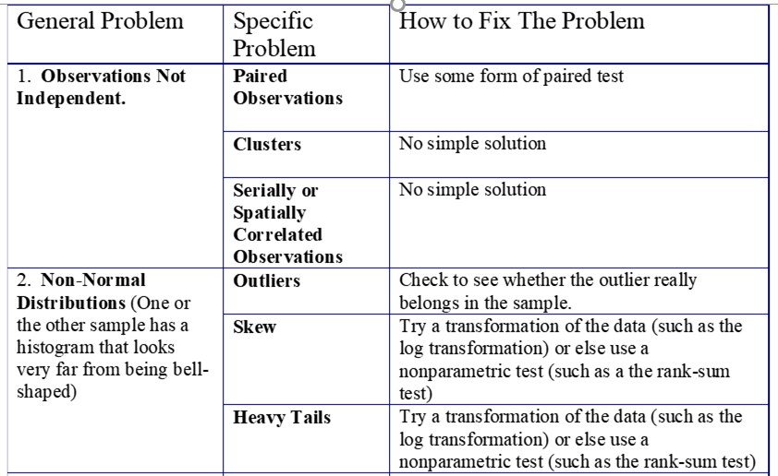
A Short Table of Problems and Fixes

